Slide 1
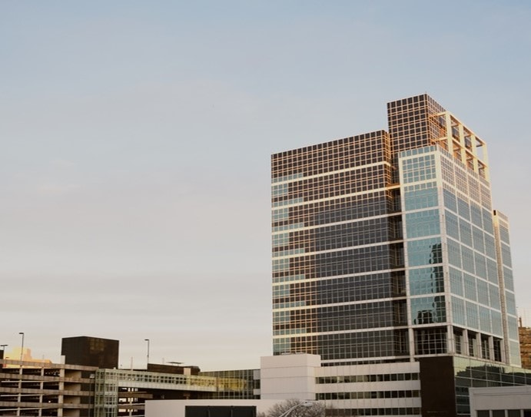

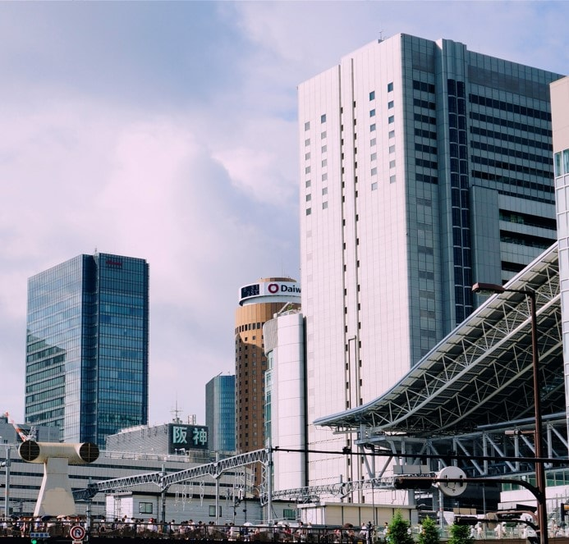


Worldwide Offices
Editable Map
Paris
Los Angeles
Tokyo
Lima
Melbourne
Notes:
© Copyright PresentationGo.com – The free PowerPoint library

Slide 2
Worldwide Offices
Editable Map
Paris
Los Angeles
Tokyo
Lima
Melbourne
Notes:
© Copyright PresentationGo.com – The free PowerPoint library

Slide 3
Notes:
© Copyright PresentationGo.com – The free PowerPoint library

