Slide 1
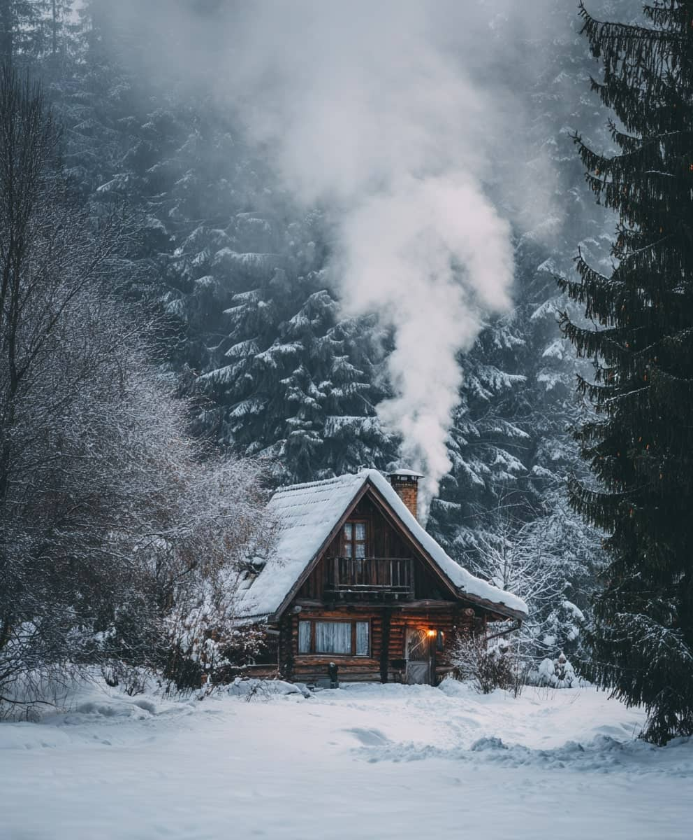
January
01
Su | Mo | Tu | We | Th | Fr | Sa
 |  |  |  | 1 | 2 | 3
4 | 5 | 6 | 7 | 8 | 9 | 10
11 | 12 | 13 | 14 | 15 | 16 | 17
18 | 19 | 20 | 21 | 22 | 23 | 24
25 | 26 | 27 | 28 | 29 | 30 | 31
Notes:
© Copyright PresentationGO.com – Free Templates & Infographics for PowerPoint and Google Slides

Slide 2

February
02
Su | Mo | Tu | We | Th | Fr | Sa
1 | 2 | 3 | 4 | 5 | 6 | 7
8 | 9 | 10 | 11 | 12 | 13 | 14
15 | 16 | 17 | 18 | 19 | 20 | 21
22 | 23 | 24 | 25 | 26 | 27 | 28
Notes:
© Copyright PresentationGO.com – Free Templates & Infographics for PowerPoint and Google Slides

Slide 3

March
03
Su | Mo | Tu | We | Th | Fr | Sa
1 | 2 | 3 | 4 | 5 | 6 | 7
8 | 9 | 10 | 11 | 12 | 13 | 14
15 | 16 | 17 | 18 | 19 | 20 | 21
22 | 23 | 24 | 25 | 26 | 27 | 28
29 | 30 | 31
Notes:
© Copyright PresentationGO.com – Free Templates & Infographics for PowerPoint and Google Slides

Slide 4
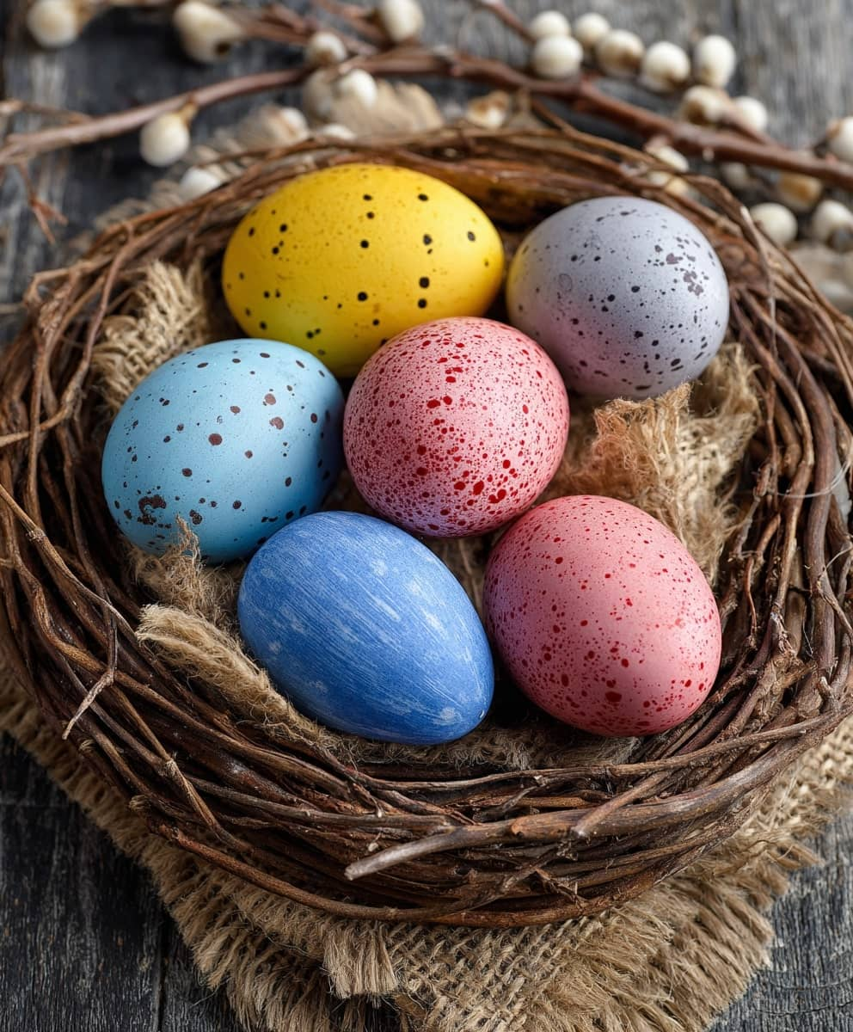
April
04
Su | Mo | Tu | We | Th | Fr | Sa
 |  |  | 1 | 2 | 3 | 4
5 | 6 | 7 | 8 | 9 | 10 | 11
12 | 13 | 14 | 15 | 16 | 17 | 18
19 | 20 | 21 | 22 | 23 | 24 | 25
26 | 27 | 28 | 29 | 30
Notes:
© Copyright PresentationGO.com – Free Templates & Infographics for PowerPoint and Google Slides

Slide 5
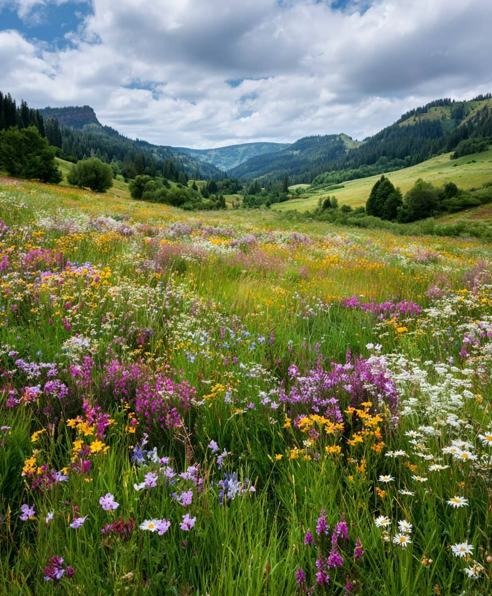
May
05
Su | Mo | Tu | We | Th | Fr | Sa
 |  |  |  |  | 1 | 2
3 | 4 | 5 | 6 | 7 | 8 | 9
10 | 11 | 12 | 13 | 14 | 15 | 16
17 | 18 | 19 | 20 | 21 | 22 | 23
24 | 25 | 26 | 27 | 28 | 29 | 30
31
Notes:
© Copyright PresentationGO.com – Free Templates & Infographics for PowerPoint and Google Slides

Slide 6

June
06
Su | Mo | Tu | We | Th | Fr | Sa
 | 1 | 2 | 3 | 4 | 5 | 6
7 | 8 | 9 | 10 | 11 | 12 | 13
14 | 15 | 16 | 17 | 18 | 19 | 20
21 | 22 | 23 | 24 | 25 | 26 | 27
28 | 29 | 30
Notes:
© Copyright PresentationGO.com – Free Templates & Infographics for PowerPoint and Google Slides

Slide 7
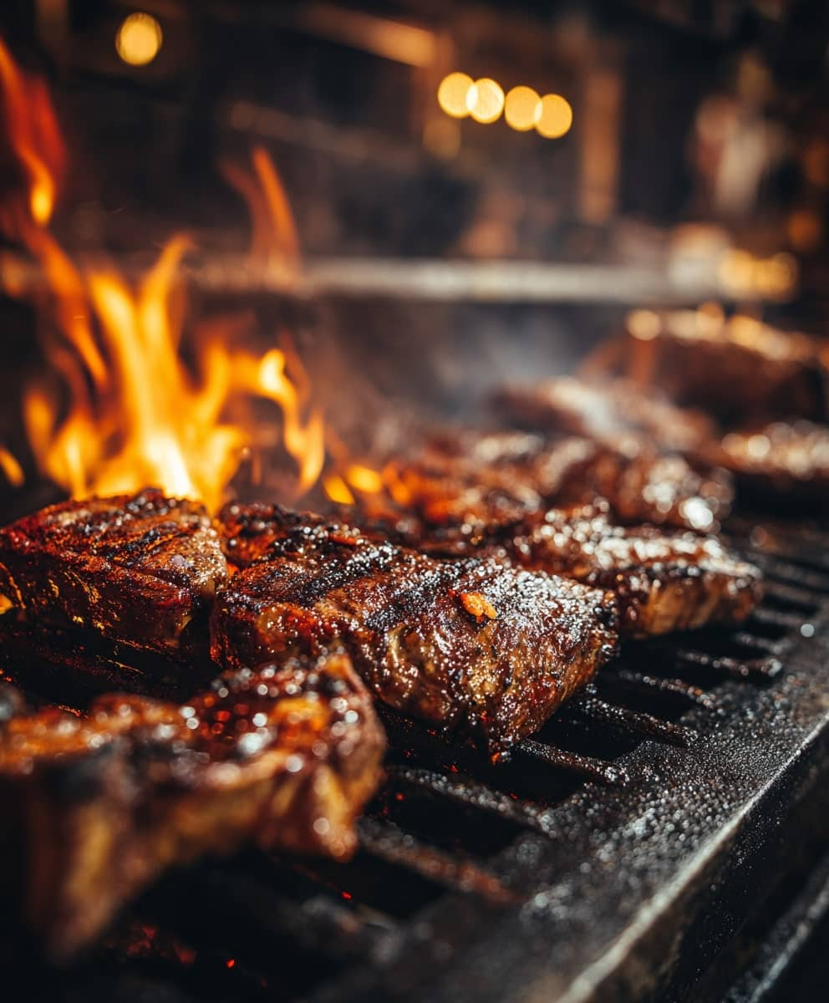
July
07
Su | Mo | Tu | We | Th | Fr | Sa
 |  |  | 1 | 2 | 3 | 4
5 | 6 | 7 | 8 | 9 | 10 | 11
12 | 13 | 14 | 15 | 16 | 17 | 18
19 | 20 | 21 | 22 | 23 | 24 | 25
26 | 27 | 28 | 29 | 30 | 31
Notes:
© Copyright PresentationGO.com – Free Templates & Infographics for PowerPoint and Google Slides

Slide 8

August
08
Su | Mo | Tu | We | Th | Fr | Sa
 |  |  |  |  |  | 1
2 | 3 | 4 | 5 | 6 | 7 | 8
9 | 10 | 11 | 12 | 13 | 14 | 15
16 | 17 | 18 | 19 | 20 | 21 | 22
23 | 24 | 25 | 26 | 27 | 28 | 29
30 | 31
Notes:
© Copyright PresentationGO.com – Free Templates & Infographics for PowerPoint and Google Slides

Slide 9
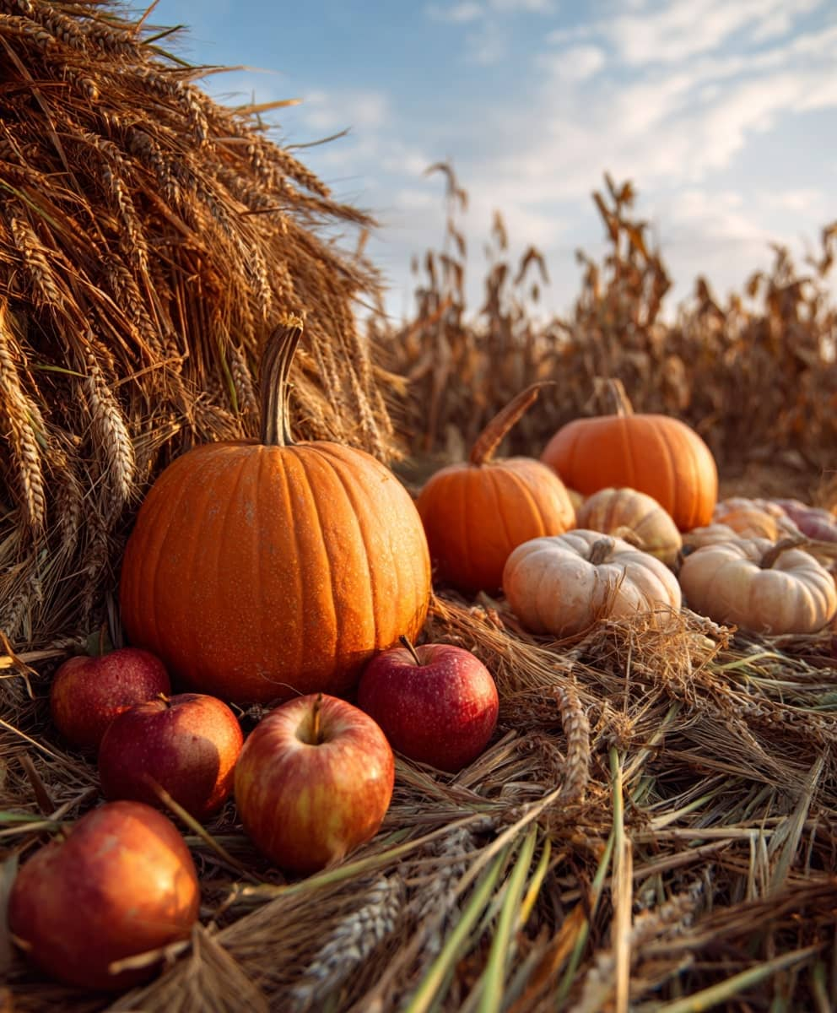
September
09
Su | Mo | Tu | We | Th | Fr | Sa
 |  | 1 | 2 | 3 | 4 | 5
6 | 7 | 8 | 9 | 10 | 11 | 12
13 | 14 | 15 | 16 | 17 | 18 | 19
20 | 21 | 22 | 23 | 24 | 25 | 26
27 | 28 | 29 | 30
Notes:
© Copyright PresentationGO.com – Free Templates & Infographics for PowerPoint and Google Slides

Slide 10

October
10
Su | Mo | Tu | We | Th | Fr | Sa
 |  |  |  | 1 | 2 | 3
4 | 5 | 6 | 7 | 8 | 9 | 10
11 | 12 | 13 | 14 | 15 | 16 | 17
18 | 19 | 20 | 21 | 22 | 23 | 24
25 | 26 | 27 | 28 | 29 | 30 | 31
Notes:
© Copyright PresentationGO.com – Free Templates & Infographics for PowerPoint and Google Slides

Slide 11
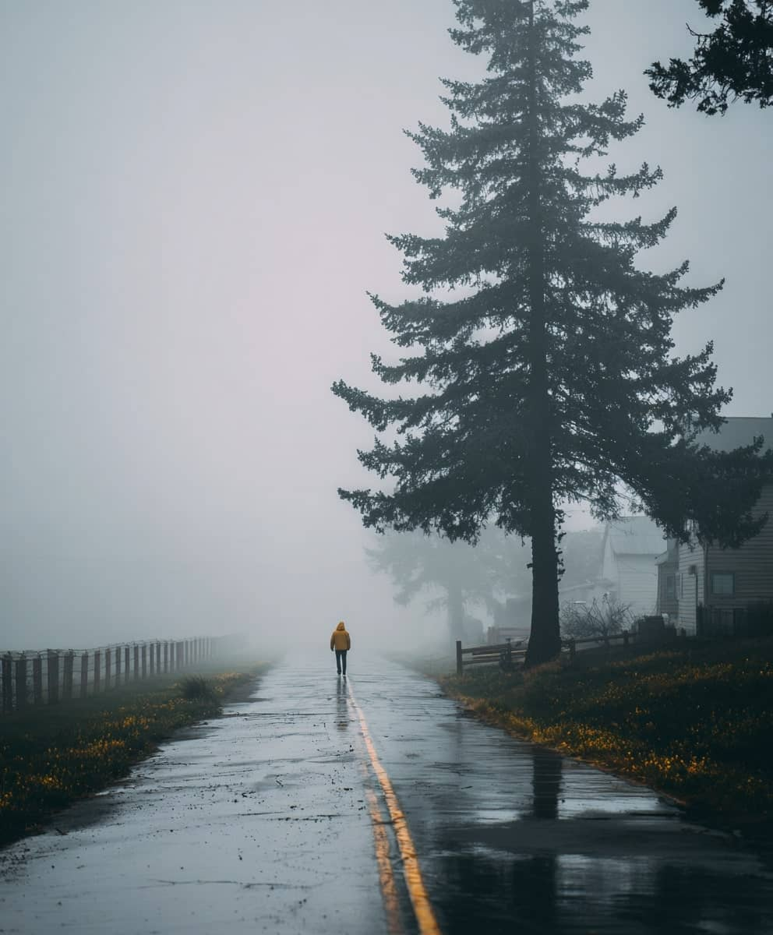
November
11
Su | Mo | Tu | We | Th | Fr | Sa
1 | 2 | 3 | 4 | 5 | 6 | 7
8 | 9 | 10 | 11 | 12 | 13 | 14
15 | 16 | 17 | 18 | 19 | 20 | 21
22 | 23 | 24 | 25 | 26 | 27 | 28
29 | 30
Notes:
© Copyright PresentationGO.com – Free Templates & Infographics for PowerPoint and Google Slides

Slide 12
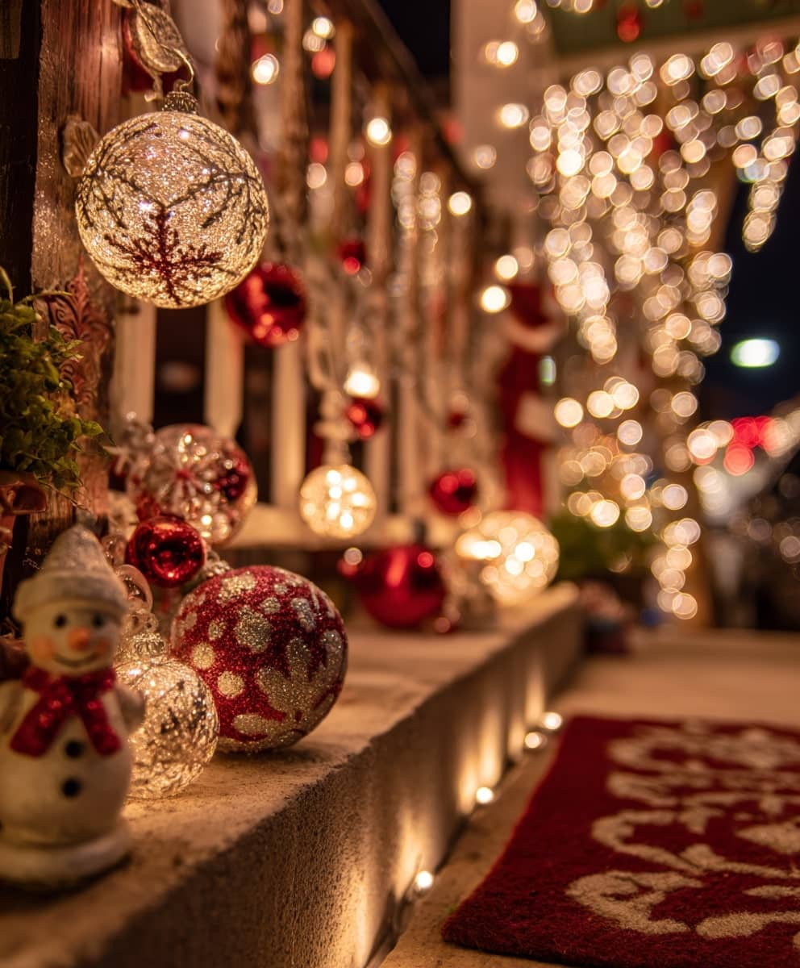
December
12
Su | Mo | Tu | We | Th | Fr | Sa
 |  | 1 | 2 | 3 | 4 | 5
6 | 7 | 8 | 9 | 10 | 11 | 12
13 | 14 | 15 | 16 | 17 | 18 | 19
20 | 21 | 22 | 23 | 24 | 25 | 26
27 | 28 | 29 | 30 | 31
Notes:
© Copyright PresentationGO.com – Free Templates & Infographics for PowerPoint and Google Slides

Slide 13
Visit our FAQ : www.presentationgo.com/faq/
Notes:
© Copyright PresentationGO.com – Free Templates & Infographics for PowerPoint and Google Slides

